Slide 1
Permutations! {Decrease and Conquer}
BY: Hamza Moustafa iD: 225077

Slide 2
Problem
You are given a positive integer n, you have to find all possible permutations of the sequence from 1 to n.
Examples: (if n = 1) = [1] (if n = 2) = [1,2] [2,1] (if n = 3) = [1,2,3] [1,3,2] [2,1,3] [3,1,2] [2,3,1] [3,2,1] etc…

Slide 3
Strategy
The strategy given is Decrease-and-Conquer, which means that the problem will be decreased by 1 each recurrence in order to achieve all of the possible permutations.

Slide 4
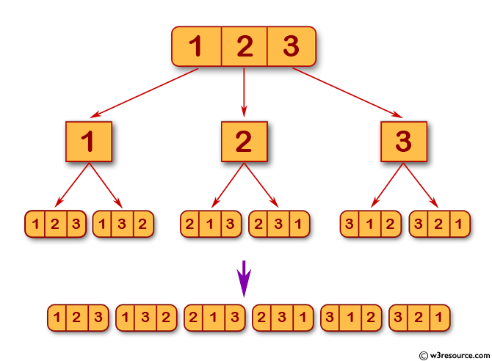
Permutations Explained
n = 3

Slide 5
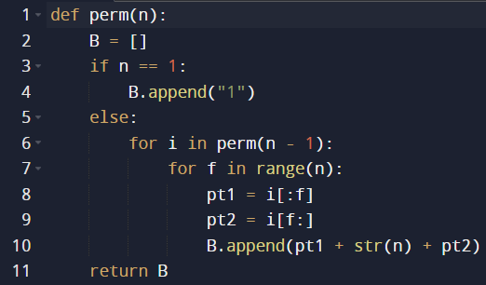
The Code Implementation

Slide 6
Analysis
Best Case
Average Case
Worst Case

Slide 7
Best Case
The best-case scenario is when n is 1, and the function directly appends 1 to the list ‘B’. In this case, the time complexity is constant, Ω(1).
T_{best}(1) = Ω(1)

Slide 8

Worst Case
If n > 1, gets lengthier with higher values of n.
$T\left(n\right)=T\left(n−1\right)+\sum_{i=0}^{n!−1}{\sum_{f=0}^{n−1}{1}}$ $T\left(1\right)=0$
Apply the constant * (Upper – Lower + 1) rule
$T\left(n\right)=T\left(n−1\right)+O\left(nn!\right)$
Substitute till you reach the value of k = n - 1
$T\left(n\right)=T\left(n−k\right)+O\left(nn!\right)=O\left(nn!\right)$

Slide 9
Average Case
The average case is also Θ(n*n!) because, on average, the algorithm will explore a similar number of permutations as in the worst case.

Slide 10
Thank you for listening!

